Slide 1
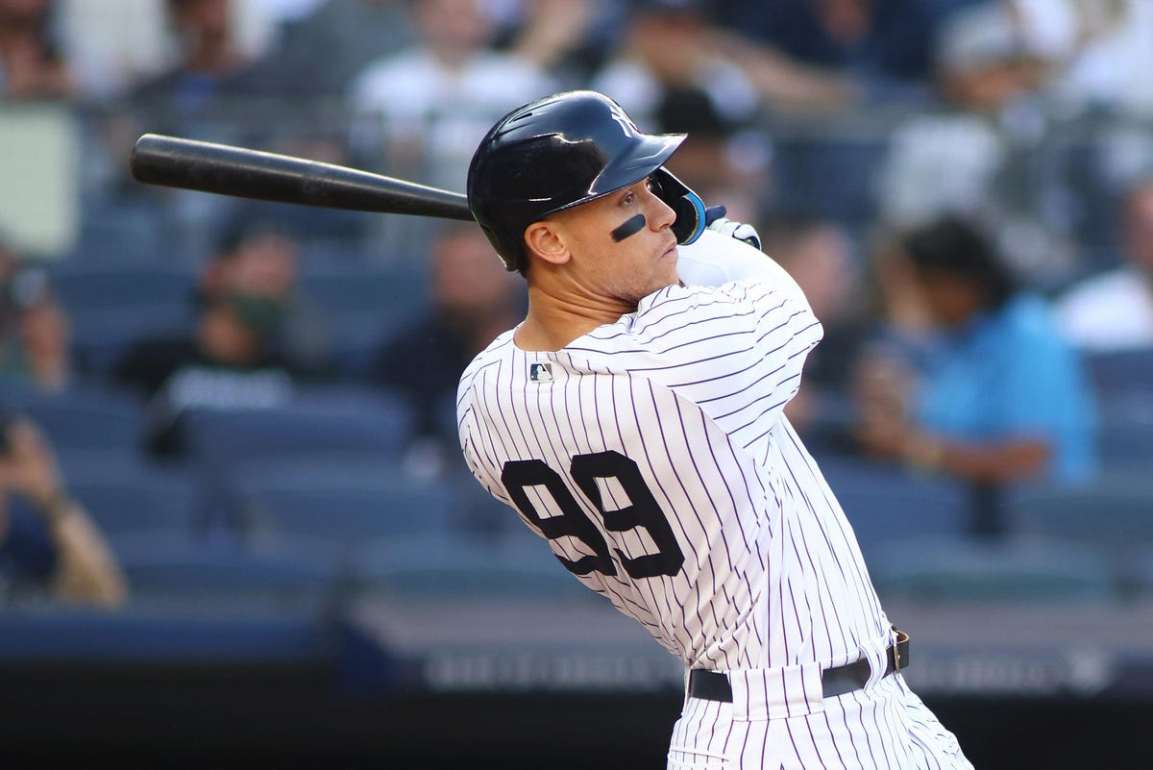

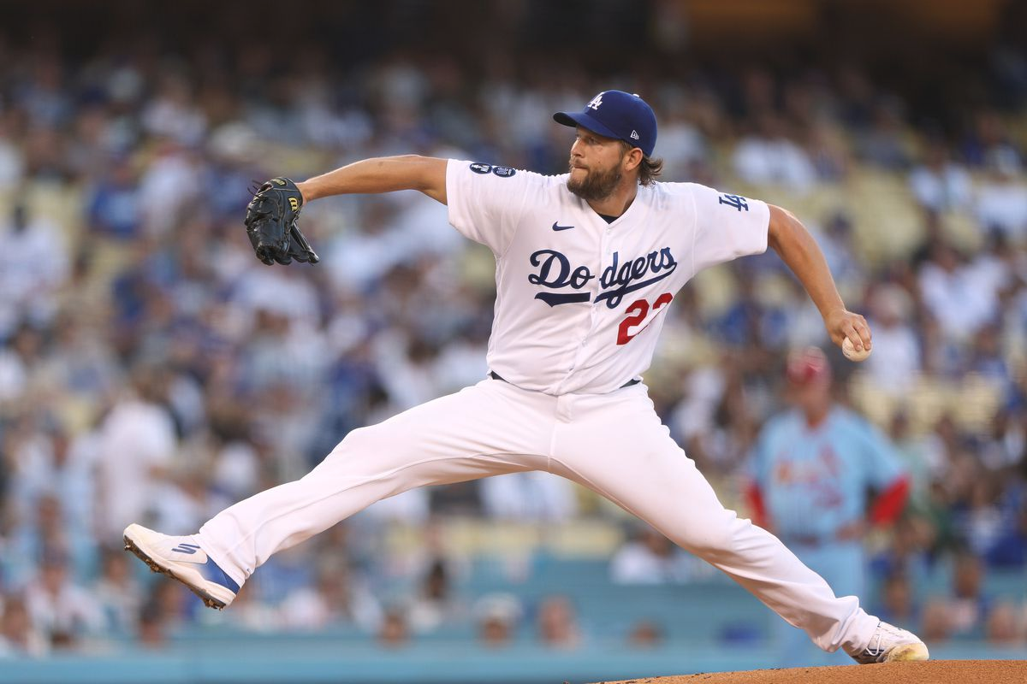
Fantasy Baseball Projections
Suhas Buravalla and Carter Rogers
DATS6501 - Data Science Capstone
.311 AVG, 62 HR, 131 RBI, 133 R, 16 SB
21 W, 1.77 ERA, 239 SO, 0.86 WHIP

Slide 2

Agenda
Overview
Background
Problem Statement
Our Data Set: Gathering, Preprocessing, Features & Targets
Modeling: Approach & Methodology
Results
Conclusion
Fantasy Baseball Projections - DATS6501

